Slide 1
Unit-III User Experience Design
By: Syed Nawaz Pasha
Assistant Professor
School of CS & AI

Slide 2
What Is UX Design?
User experience (UX) refers to the user’s journey when interacting with a product or service.
How is the user introduced to the service or product?
What kind of interaction does the user have ?.
How does the user feel after the interaction?
A UX designer’s primary goal is for each user to have a positive interaction with a product or service.

Slide 3
What is UX Research?
UX (user experience) research is the systematic study of target users and their requirements, to add realistic contexts and insights to design processes.
The Nielsen Norman Group—an industry-leading UX consulting organization—identifies appropriate UX research methods which you can use during a project’s four stages.

Slide 4
UX Research Process
Discover – Determine what is relevant for users.
Contextual inquiries
Diary studies
Explore – Examine how to address all users’ needs.
Card sorting
Customer journey maps
Test – Evaluate your designs.
Usability testing
Accessibility evaluations
Listen – Put issues in perspective, find any new problems and notice trends.
Surveys/Questionnaires
Analytics

Slide 5
Psychology and Human factors
Psychology is an integral part of the User Experience(UX) design.
Design psychology is a combination of neuroscience, cognitive psychology, social psychology, and human-computer interaction that approaches user experience design through the lens of human behavior.

Slide 6
What is the relationship between UX and psychology?
UX design is all about human psychology.
It is not about designing a product but more like designing an interaction with the user.
Thus, having an understanding of psychology can give UX designers an advantage when it comes to UX, as it is all about knowing users, users weaknesses, strong points, and fears.

Slide 7
Human factor design principles
Physical ergonomics
Consistency
Familiarity
Sense of control
Efficiency
Error management

Slide 8
Physical ergonomics
Physical ergonomics refers to the responses of the human body to physical work demands, such as the use of hand muscles when holding a smartphone or touching a screen.
Proper ergonomic design is necessary to enable comfortable interaction with a product.
arrangement of controls and display
physical environment
health issues
Temperature
Lightning
Time
Noise
the use of colors

Slide 9
To assess whether the product is good for the user, human factors specialists take into account:
Specific operations that the user performs with the product such as entering text into a web form.
Physical characteristics of the product such as size, shape, and weight of a mobile phone.
Context of use such as how users interact with information on that device.
For example, when we apply human factors to mobile app development, we adjust the size of touch controls to minimize the risk of user error.

Slide 10
Consistency
This principle states that a system should look and function the same everywhere.
Consistency in design plays a key role in creating comfortable interactions.
When a product has a consistent design, a user can transfer their learned skills to other parts of the product.
It is also important to maintain both internal and external consistency:
Internal Consistency. Apply the same conventions to all user interface
elements. For example, if you are designing a graphical user interface (GUI), use the same visual appearance of the elements of UI throughout.
External Consistency. Use the same design across all platforms of the
product, e.g. desktop, mobile, etc.

Slide 11
Familiarity
The principle of familiarity states that it is important to use familiar concepts and metaphors when designing human-machine interfaces.
The design industry loves innovation, and it is very tempting for designers to create something new and unexpected.
But at the same time, users love familiarity. When they spend time using products other than ours, they become familiar with the standard conventions of design and begin to expect them.

Slide 12
Sense of control
Human-computer design is all about the user is control of the information. The user is the one who should control the interaction with a system, not the other way around. Here are a few things to keep in mind when designing a product:
Appropriate Feedback. Use visual and auditory cues to help users
understand the current state of a system.
Control over system operations. Users should have control over
system operations, such as pausing or stopping actions.
Personalization. Provide content based on what you know about the user to give the impression that the system is adapting to the user ‘s needs.

Slide 13
Efficiency
Users should be able to complete their tasks in the shortest amount of time possible.
Break down complex steps into simple steps.
Reduce the number of operations required to complete the task.
Guide the user.
Summarize related information.
Provide shortcuts.

Slide 14
Error management
Prevent errors from occurring whenever possible.
Protect users from fatal errors.
Dialogs and actions.
Never blame the users.

Slide 15
Psychology and Human Factors
Psychology is the scientific study of the human mind and its functions
Human factors
Impatience
Limited memory
Need analogies
Limited concentration
Changes in mood
The need for motivation
Fears
Make errors
Misjudgement
Prefer speech
Process information

Slide 16
Human Factors
Can only perform a limited number of concurrent tasks
Short-term memory works differently than long-term memory
Users are all different
Think in terms of ideas composed of words, numbers, multimedia
Must see and hear to understand
Physical inability
Need complex information presented hierarchically
Confined to one physical location at a time
Require practice to become good at doing things
Tend to do things the easy way
Can be physically harmed by some tasks
Prefer to learn by doing than by explanation

Slide 17
Human Factors
Have difficulty converting ideas into modes of communication
Have difficulty converting modes of communication into ideas
Act irrationally
Become nervous
Miss details when tasks are memorized and performed cursorily
Can be affected by socio/political climate.
Prefer standard ways of doing things
Constrained by time
Work better in groups than individually (1+1=3)
Require tasks to be modularized in order to work in groups
Rely on tools to complete tasks (like spell checking) thus causing dependency
Become addicted

Slide 18
Conceptual Models
The conceptual model is the mental image people create in their minds after looking at something.
In interface design, it refers to the model that users think of how an interface is supposed to work.

Slide 19
Conceptual Model
The conceptual model must be intuitive and should match the tasks supported by the interface.
This way, users can more accurately predict the working of the interface, and make their performance more efficient

Slide 20
Conceptual model design
1. Define the conceptual model as product/process-oriented.
2. Identify products/processes
3. Design presentation rules for products/processes
4. Design rules for windows
5. Design major navigational pathways

Slide 21
1. Define the conceptual model as product/process-oriented.
The first step is to decide whether the application under design is product-oriented or process-oriented.
Product-oriented applications have a clear work product that can be created and saved.
Ex: Google Drive, Word Document.
process-oriented applications support some work processes.
Ex: Online application filling

Slide 22
2. Identify products/processes
Once the conceptual model is defined, the next step is to identify the key products or processes that the user interacts with.
Product-Oriented Example:
Google Docs: The products are the documents, folders, and files that users create and manipulate.
Process-Oriented Example:
Online Banking: The processes might be transferring money, paying bills, or viewing account statements.

Slide 23
Design presentation rules for products/processes
Presentation rules define how information and products/processes are presented visually to the user.
Product-Oriented Presentation Rules:
Icons,Layouts
Process-Oriented Presentation Rules:
Steps and Progress Indicators
Form Fields

Slide 24
4. Design rules for windows
The design rules for windows guide how multiple windows or sections of the interface should behave to improve the user experience. This includes consistency, clarity, and how information is displayed across different screens or windows.
Product-Oriented Window Design:Multi window
Process-Oriented Window Design: Sequential window

Slide 25
5.Design major navigational pathways
Navigational pathways are the routes users take to move through the system. Good navigation ensures that users can quickly find and access the products or processes they need.
Product-Oriented Navigation: Hierarchical Navigation,Search Functionality.
Process-Oriented Navigation:Step-by-Step Navigation,Back and Forth Navigation.

Slide 26
Example
Online Shopping System (Product vs. Process-Oriented)
Product-Oriented Conceptual Model:
Products: Items (e.g., clothes, electronics) are the main focus.
Presentation: Products are displayed in categories, with icons, images, and prices.
Window Design: Each product opens in its own window, displaying details and options for purchase.
Navigation: Users can browse products via search or category filtering.
Process-Oriented Conceptual Model:
Processes: The system focuses on the process of purchasing an item.
Presentation: Each step in the buying process is clearly defined (e.g., select item > add to cart > payment).
Window Design: Each step of the process opens in a new window, guiding users through the transaction.
Navigation: Users follow a linear path through the buying process, with clear instructions and the ability to go back and adjust selections.

Slide 27
Mistakes and Error
Errors are defined as deviations that are competence-based and occur as a result of a lack of knowledge.
The main reasons for human errors are due to incomplete specification, design defect and error in implementation.
In any complex system, human operators are the biggest sources of error.
Mistakes are performance-related and occur even though the learner has the knowledge.
A mistake is making the wrong decision about what to do.

Slide 28
Types Of Errors and Mistakes
Error types
Slips (Slips are mistakes caused by temporary factors such as a learner being tired, nervous, excited or distracted)-goal correct,
Action incorrect (attentional failure);
Laps -goal correct,
Mistake Types:
Goal incorrect,
Action correct/incorrect.
Slips (i.e., entering in accurate parameters for a charge point/location) were counted by the researcher during the experiment.

Slide 29
Social psychology
Social psychology is the scientific study of how people’s thoughts, feelings, and behaviors are influenced by the actual, imagined, or implied presence of others.
Social psychology offers a higher level of analysis that takes into account groups and their behavior in an organization.

Slide 30
Interface implementation and Evaluation:
User interface provides a way of communication between a user and a computer
Interface design, as the name suggests, refers to creating the model of user interfaces for some software.
Before a user interface design is finalized, it needs to be evaluated in terms of quality.

Slide 31
What is evaluation?
Evaluation helps test whether the interface meets the set requirements or not.
A design evaluation highlights problems before the design is sent for the final implementation.
Ideally, evaluation should not be left to the end of the design process.
Instead, it should be a continuous activity where individual interface components are assessed during the design process.

Slide 32
Evaluation techniques
The techniques to perform evaluation can be broadly divided into two categories:
Evaluations that require expert analysis.
Evaluations that require involving user participation.

Slide 33
Evaluation through expert analysis
heuristic evaluation technique, evaluators critique the interface design, keeping some usability heuristics or principles in mind.
A cognitive walkthrough involves the evaluators performing the sequence of actions for each task and evaluating their learnability and usability from the users' perspective.
A model-based evaluation involves assessing the interface using some models of design specifications. One such model is the GOMS model.
An evaluation can be found based on previous studies or existing studies and experiments regarding specific interface designs. The expert evaluators sometimes make use of these studies to assess the interface.

Slide 34
Evaluation through user participation
In the experimental evaluation technique, controlled experiments are carried out to test specific hypotheses regarding the interface design.
The observational techniques involve watching the users and recording their behavior to understand their thought processes while using the interface.
The query techniques include asking the user directly about their experience with the interface, such as interviews and questionnaires.
Monitoring physiological responses is a way to take physiological measurements of users while they are exposed to the interface and analyze them.

Slide 35
Factors in Experimental Evaluation
Participants: actual users of interface
Variables: attributes that can be measureds and evaluated
Independent variable
Dependent Variable
Hypothesis: Predictive statement expressed in terms of independent and dependent variables.
Experimental Design: Design of an experiment can be between-subjects or within-subjects.
Statistical Measures : contain statistical data to conclude the results.

Slide 36
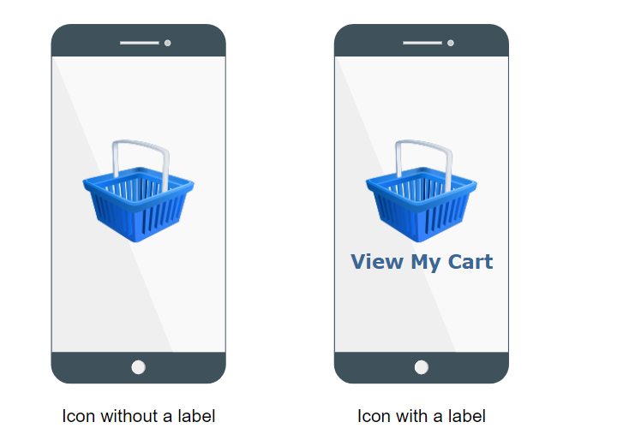
Experimental Evaluation
Decide weather to use icon with label or without label in our interface design
Independent Variable: Usage of Icon
Dependent Variable: No of user mistakes
Hypothesis: There will be fewer errors if an icon is used with label

Slide 37
Goals of evaluation
Assess the system's functionality
Assess users' experience with the interface
Identify specific problems with the interface

